Slide 1
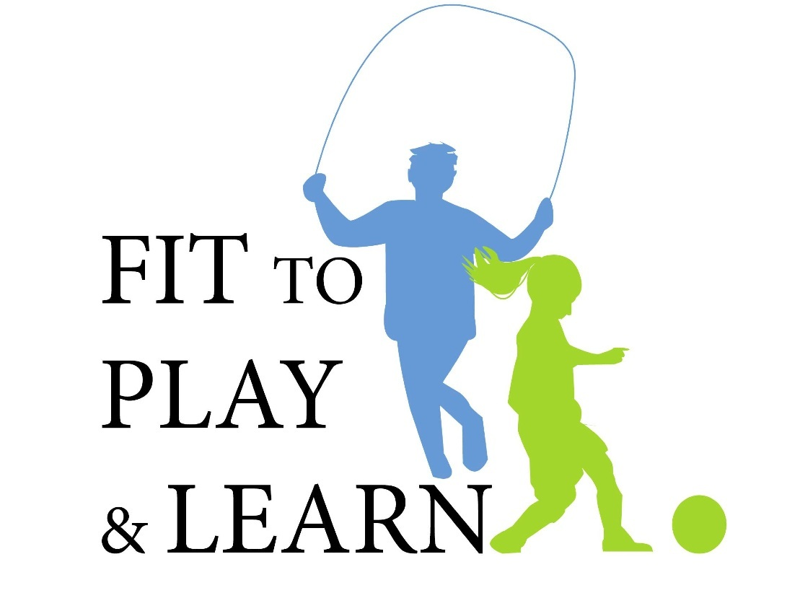
Fit to Play & Learn: You Are What You Eat!
AN OBESITY PREVENTION PROGRAM SPONSORED
AND DEVELOPED BY CHAPTER 2 OF THE AAP

Slide 2
What is your favorite food?
Notes:
Initiate discussion with students about their favorite kinds of food.
Get a sense of what they usually eat on a daily basis.
Questions to ask:
What are your favorite foods?
Are these foods good for you?
What kind of foods are bad for you, if you have too many of them?

Slide 3
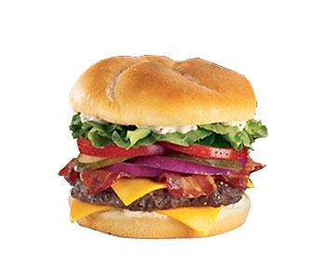
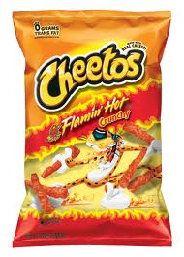
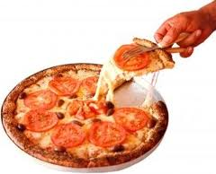
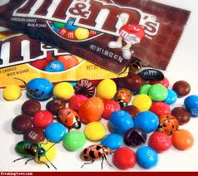
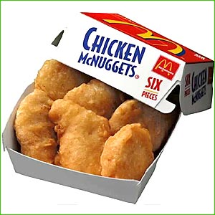
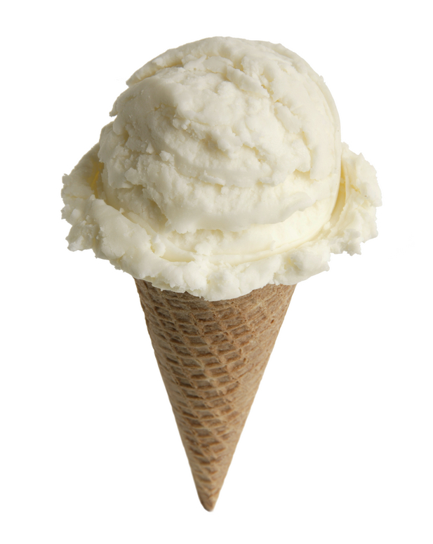
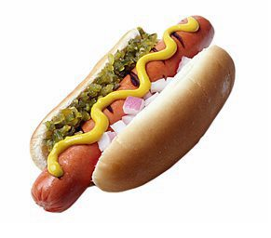
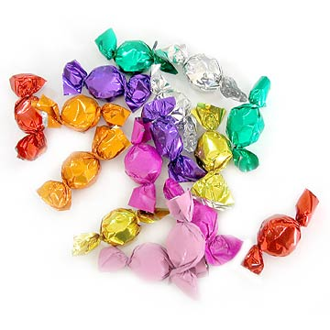
Junk Food
Notes:
Go through the pictures and ask students for more examples of “junk food”.
Describe what makes the food “junk”
Too much sugar
Too much fat
Fried
Explain that these foods are only “sometimes” foods

Slide 4
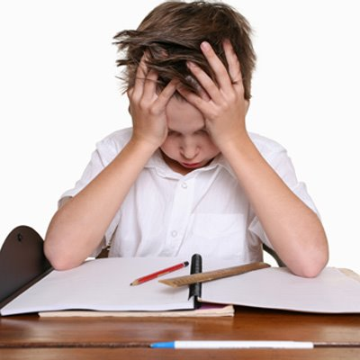
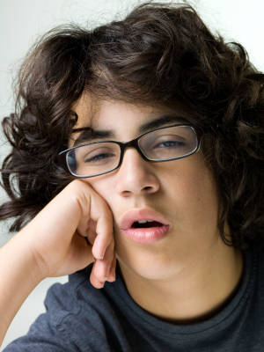
Sluggish, tired, can’t think straight…
How do you feel when you eat junk food?
Notes:
Talk with students about how they feel when they eat junk food or too much food (use Thanksgiving as an example).
Click through to pictures of tired and struggling students.
Ask students to describe what happens when they eat sugary or fried foods – how do they feel after a BIG Turkey dinner at Thanks giving.

Slide 5
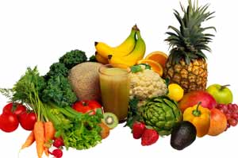
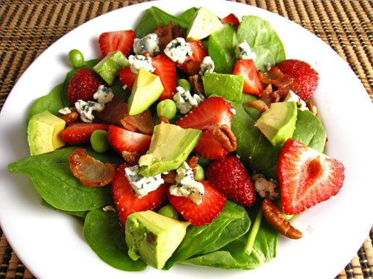
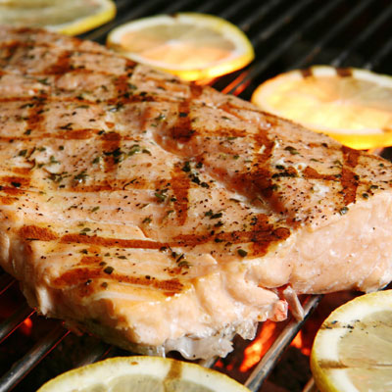
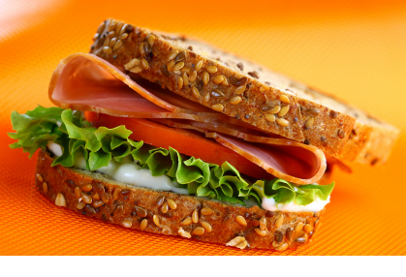
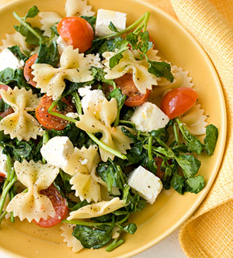
Healthy Foods are Fresh Foods
Notes:
Now ask students for examples of healthy foods.
Talk through what makes them healthy –
Whole grain
Low Fat/Fat Free
High Fiber
Fresh Fruits and Vegetables (not fried or in syrups)

Slide 6
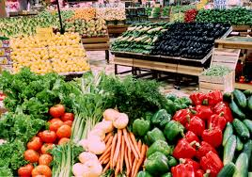
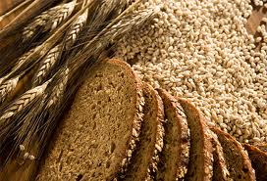
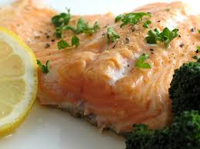
Make Half Your Plate Fruits and Vegetables.
2. Make at least Half your Grains Whole Grains.
Look for 100% whole grain or
100% whole wheat on labels.
3. Choose a Lean Protein.
Try to have seafood twice a week.
4. Choose Low-fat or Fat-free Dairy
Notes:
Pass out the Build a Healthy Meal Handout.
Pre-Pre Activity:
Print out a Build a Healthy Meal Handout for each student.

Slide 7
Healthy Foods are Fresh Foods
Whole grain
Low Fat/Fat Free
High Fiber
Fresh Fruits and Vegetables (not fried or in syrups)

Slide 8
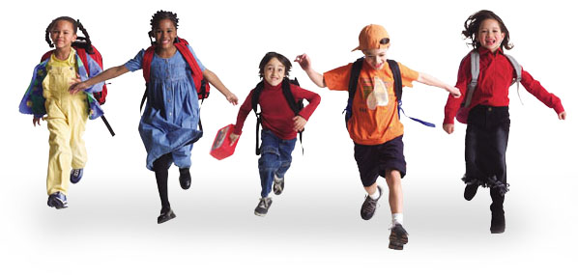
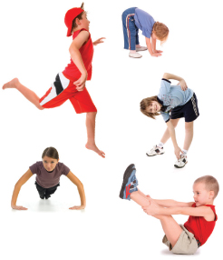
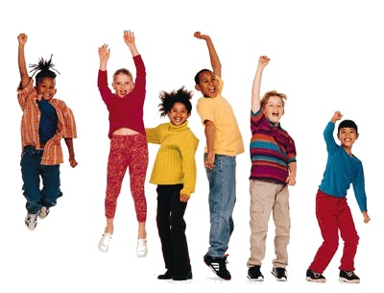
Alertness
Energy
Strength
Notes:
Talk with students about how they feel after a good healthy meal.
What will a healthy snack do for them?
More energy
Make them stronger
Why is it important to eat a healthy diet?
-Impacts how well you perform in school, your grades, how able to are to pay attention in class/staying alert
-Helps you stay more active v. lazy/sluggish; gives you more energy in general
-Health reasons: eating unhealthy leads to all kinds of diseases and illnesses
-if you eat healthy, you’re less likely to get sick with something as small as a cold or as big as cancer/diabetes/etc

Slide 9
How can you develop healthy eating habits?
Think before you eat
Watch HOW MUCH you eat
Keep it in the kitchen
Notes:
Talk through each of these elements and how students can practice healthier habits by:
-- think about what they are eating so they can make good choices
-- keep track of “how much” they are eating by watching the portions
-- try to only eat in the kitchen, instead of in front of the TV or while studying

Slide 10
Keep Your Life in Balance
Calories
IN
Exercise
OUT
Notes:
Everything you eat has an effect on your body. Foods that are healthy for you (fruits, veggies, eggs) have more of the good calories full of fiber, protein and vitamins. Your body turns these good calories into energy so you can play and run. They also make you stronger and healthier.
When you eat junk food, those calories are bad for you. Junk food is usually made up of too much sugar and fat. Instead of turning the calories into energy, your body takes calories from junk food and absorbs them into fat. These bad calories lessen your strength and health!
You can work on becoming healthier by counting the amount of calories and vitamins, fiber, good carbohydrates and protein you eat every day.

Slide 11
How many calories should you eat per day?
Age | 1 Year | 2–3 Years | 4–8 Years | 9–13 Years | 14–18 Years
Calories† | 900 kcal | 1000 kcal
Female |  |  | 1200 kcal | 1600 kcal | 1800 kcal
Male |  |  | 1400 kcal | 1800 kcal | 2200 kcal
Notes:
American Heart Association Chart
Key Point: Adults need to eat more calories than children.
Note to speaker: Ideal caloric intake varies by the individual needs and activity. Those who are more active need more calories.

Slide 12
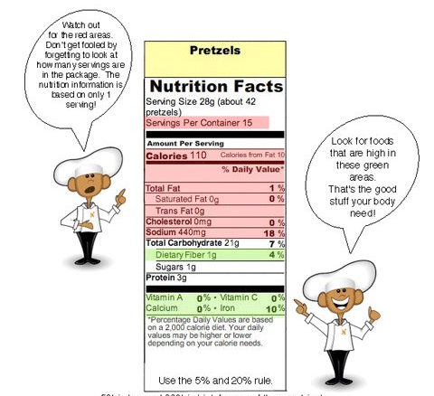
How to read the labels!
Notes:
Use this time to have the students partner up and look at the food label handouts.
Activity Prep: What your need for this activity:
Request students to bring in labels from boxes/packages they eat at home. (Speaker should have additional labels on hand in case students forget)
Print one of each handout for each student.
a) http://www.nourishinteractive.com/free_printables/food-labels/understanding-food-labeling-basics-nutrition-picture-kids-3-simple-steps-eating-healthy-reading- food-labels.pdf
b) http://www.nourishinteractive.com/free_printables/food-labels/easy-basic-kids-food-labels-facts-red-light-green-light-childrens-nutrition-printout.pdf
Activity:
Explain how every food comes with a label that gives you details about what is in your food - Including, fiber, protein, carbs, sugars and fats.
Have students review the labels they brought in to class and use the handouts to determine how good (or not so good) those foods are.

Slide 13
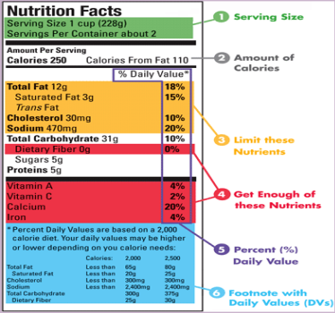
What’s in your food?

Slide 14
Now that you know how to read the labels,
you can know what you are putting in your body.
By keeping a food log, you can keep track of the foods
and the calories that you eat a day.
Notes:
Pass out food log. Explain to class how to use it. This will be this sessions homework assignment.

Slide 15
Being Healthy is NOT about Starving Yourself
If you think you need to lose weight, talk to your doctor.
Your doctor can suggest a healthy weight loss goal.
Most people should not lose >1 pound a week.
If you are still growing, you may not need to lose weight at all. You may need to just not gain weight.
Your doctor can help figure out what is the best plan for you.

Slide 16
Why shouldn’t I starve myself? Won’t I just lose weight faster?
To be healthy, you need to eat healthy foods and exercise.
When your body doesn’t get the nutrients it needs, it slows itself down.
Your body’s metabolism is how fast it burns calories.
Your body will burn fewer calories because it is trying to save them.
If you eat a healthy meal and exercise, your body’s metabolism speeds up.

Slide 17
Being Healthy is NOT about not eating.
It is about eating the RIGHT foods.

Slide 18
What we learned today!
You are what you eat.
Eating well gives you energy.
Eating well helps you think and study.
Reading labels lets you know what you are eating.
Starving yourself is NOT the right answer.

Slide 19
What’s next….
Homework:
Food Log
Next Session: Healthy Foods for a Healthy Life
How to build a healthy plate
Snacks that taste good and are good for you
Portion size

