Slide 1
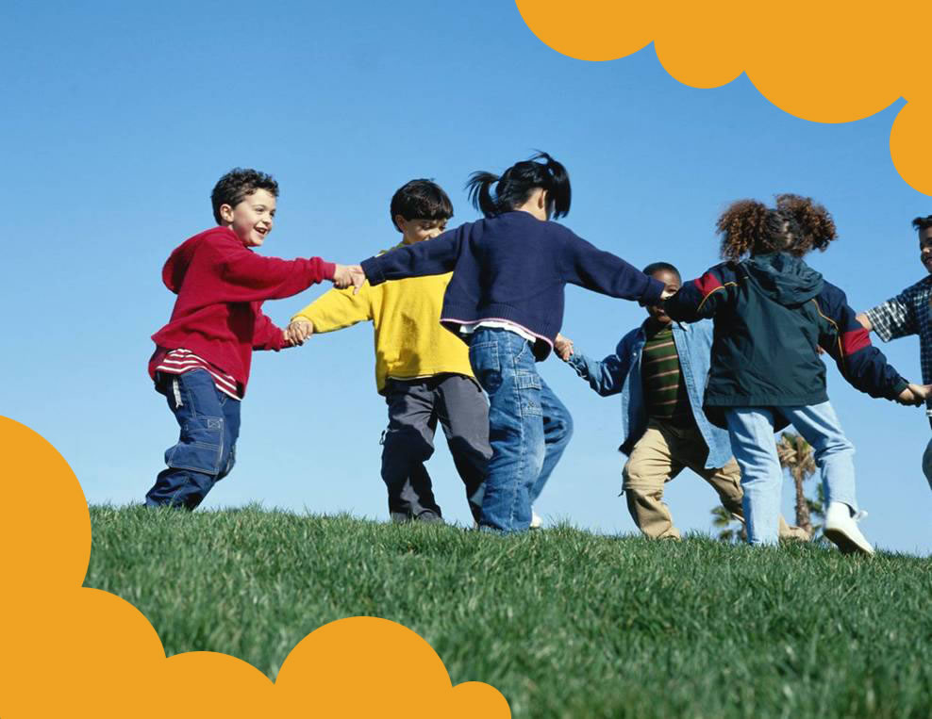
Get Moving!
AN OBESITY PREVENTION PROGRAM SPONSORED
AND DEVELOPED BY CHAPTER 2 OF THE AAP

Slide 2
What we’ve learned during the past sessions
Why it’s important to be healthy
How to develop & continue healthy eating habits
Rethink Your Drink: Be Sugar Savvy
BUT, there’s more to being healthy than eating & drinking the right things…

Slide 3
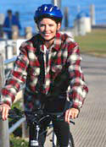
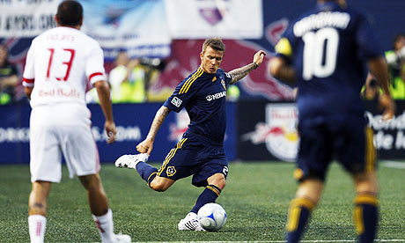
Get Moving
Kids need at least ONE HOUR per day!
Notes:
Use this slide to talk with students about what kind of activities they enjoy.
Highlight that kids need at least one hour of exercise per day!

Slide 4
It’s time to get movin’!
Notes:
Physical Activity (Group)- 5 minutes
Presenters can decide what works best for this demonstration. If Instant Recess videos are available, this can be used.
Examples: Jogging in place, jumping jacks, stretches, dance video, relay race, etc.

Slide 5
Anything that requires moving counts!
Chores (Sweeping, Raking leaves, Vacuuming, Mopping)
Walking to school
Get up and move during TV commercial breaks
Walking around the mall or store
Walking the dog
Take the stairs
Dancing to music

Slide 6
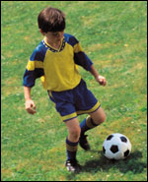
Kids should do 1 hour or more of physical activity per day!
Aerobic Activity (Every day)
Brisk walking, dancing, running
Muscle Strengthening (3 days/week)
Gymnastics, push-ups
Bone Strengthening (3 days/week)
Jump rope, running
TIP: Many exercises fall into different types! For example, playing basketball is both aerobic and bone strengthening.

Slide 7
How do I stay active?
Make physical activity part of your family routine. Take walks or play games!
Utilize safe parks, public pools, basketball courts, and baseball fields.
Make physical activity fun. Play team sports, individual sports, bike, skate, dance, and more!
Be safe! Use protective equipment, such as helmets, knee pads, wrist pads, and tennis shoes.

Slide 8
Now YOU are Fit to Play and Learn!
You Did It!
Let’s Review:
What Did We Learn Over the Fit to Play and Learn Course?

Slide 9
Easy ways to change…
1. Get 1 hour of physical activity a day!
Play Outside After school.
Pick your favorite activities. Start with 10 minutes every day. Steadily increase when it becomes too easy until you are doing it for an hour a day.
2. Limit junk food to “sometimes” (1 time/week)
3. Try to eat as many colors of the rainbow as you can every day (NOT orange Cheetos!)
4. Drink more water and less sugary drinks
5. Do it as a Family!

Slide 10
Eat healthy, be healthy
Look for foods that are low in calories
Eat more foods with whole grains and low fat
High fiber foods are your friend
Watch your portions
Keep your food in the kitchen & not in front of the TV or computer
Notes:
-Remind students about the food label activity & rainbow foods handouts we reviewed in Session 2.

Slide 11
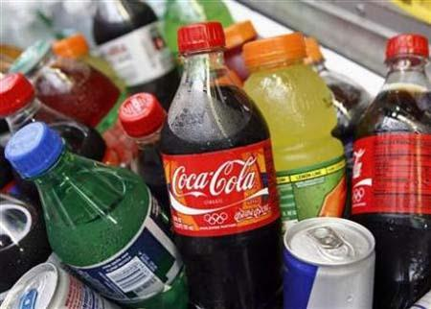
Healthy DRINK choices are important for your health too!
Don’t Forget!
Too much sugar and calories can lead to weight gain, obesity, and serious health problems.
Water is the BEST drink option for your health!

Slide 12
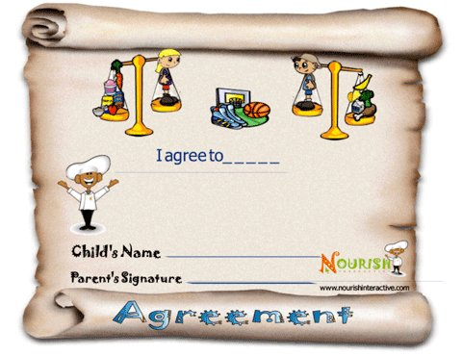
Let’s put what we learned into action!
Take the Pledge!
Notes:
Pre-Activity Prep:
Print out pledge sheets for each student and Activity Log
Each student will need a writing utensil.
Pass out Healthy Eating & Being Plan. Have students complete the pledge form and have parents and students sign.
Pass out Activity Log and explain to students that they can use the log to keep track of how well they are working towards fulfilling their pledge.

